Slide 1


Design of a regulation and feedback control system for a synchronous generator with varying load with simulink.
Group ID:1906170
1906171
1906172
1906173
1906174
1906175
1906176
Lab group: 2

Slide 2

Synchronous generator:
* Rotor is used to produce a magnetic field
* Rotating magnetic field is produced from the rotor
* This rotating magnetic field is used to induce voltage in the stator.
* Induced voltage will be 3-phase.
* Field winding will be on the rotor and armature winding will be on the stator.

Slide 3
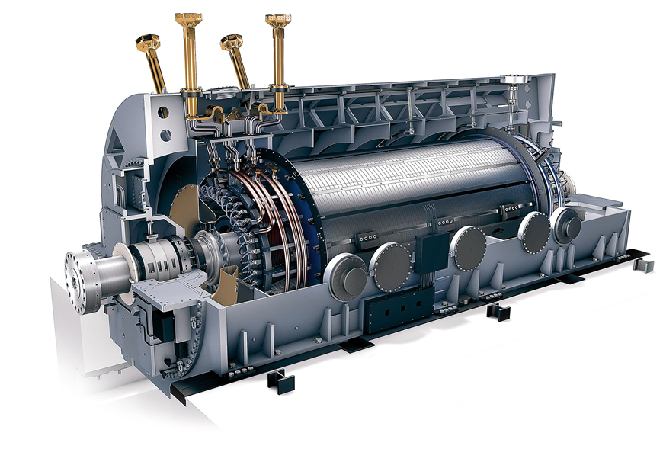
Figure: A synchronous generator

Slide 4


In this project:
We have observed the changes in terminal voltage with varying load .
Observed the changes of terminal voltage with and without feedback.
Corrected the power factor change using capacitor bank

Slide 5

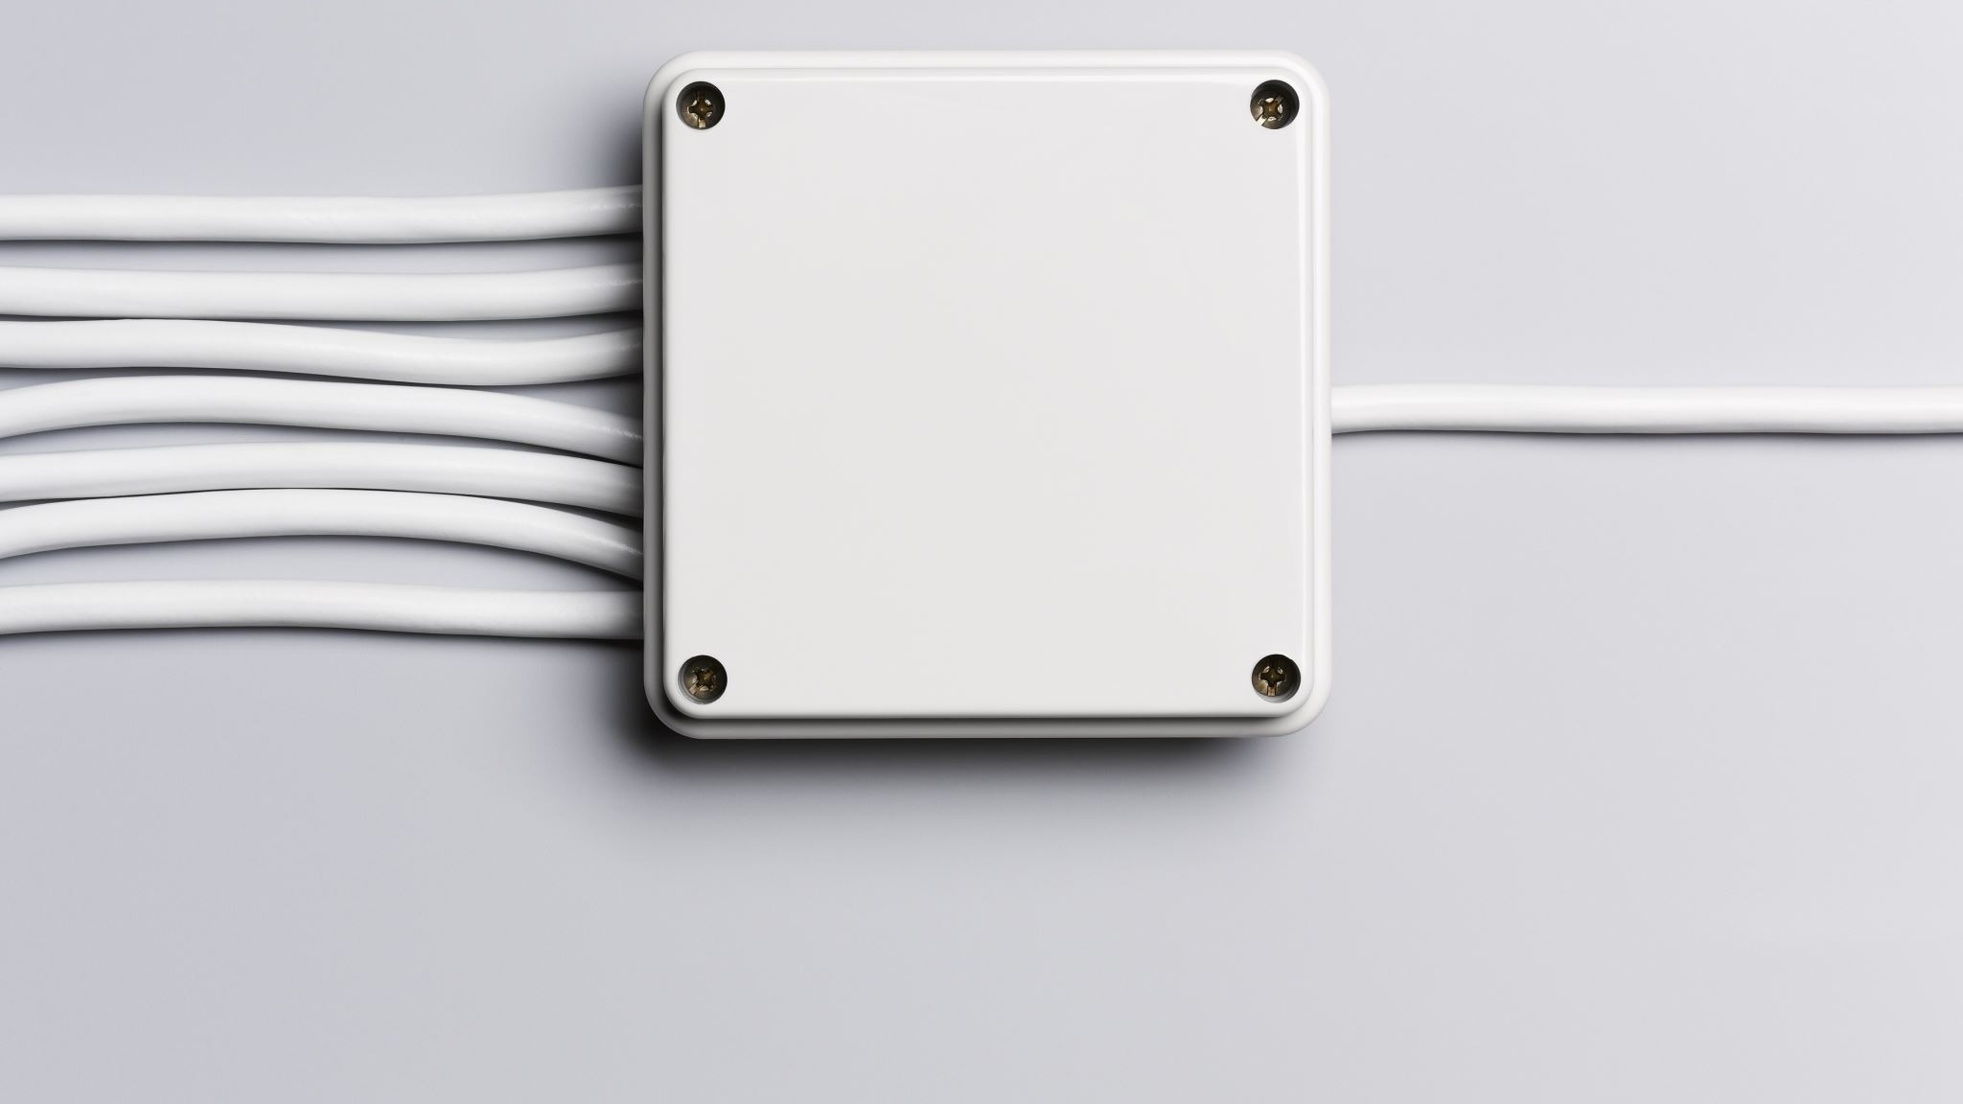
Observing changes in the terminal voltage by varying load:
We have at first taken the no load terminal voltage
Then, we have changed the load and observed the terminal voltage without feedback.
After that, we did the same thing with feedback in the rotor speed side.
At last, we used the feedback in the excitor voltage side and observed the terminal voltages

Slide 6
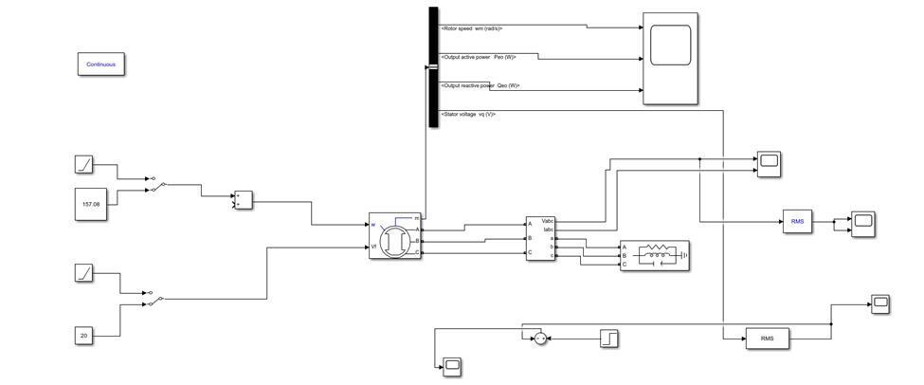
Figure: Schematic diagram without using feedback

Slide 7
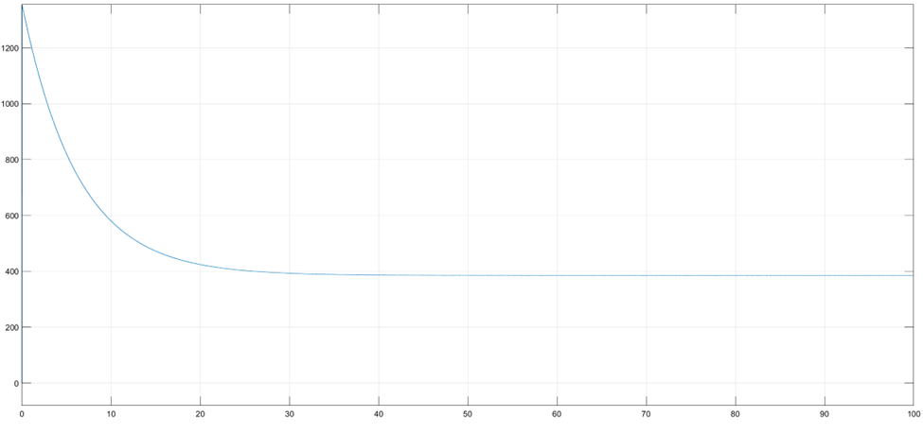
For no load condition:
Figure: RMS voltage for no load condition.
RMS voltage=385.3V

Slide 8
Now, we observed the terminal voltages by varying the value of inductive reactive power of the load without using any feedback. The real power was kept constant (10KW).
Lagging load(KVAR) | Terminal Voltage(V)
2 | 379.3
4 | 374.1
6 | 369.5
8 | 364.9
10 | 360.3
Leading load (KVAR) | Terminal voltage
2 | 388.5
4 | 392.2
6 | 396.1
8 | 400
10 | 404.1
Table: Changing leading load
Table: Changing lagging load

Slide 9
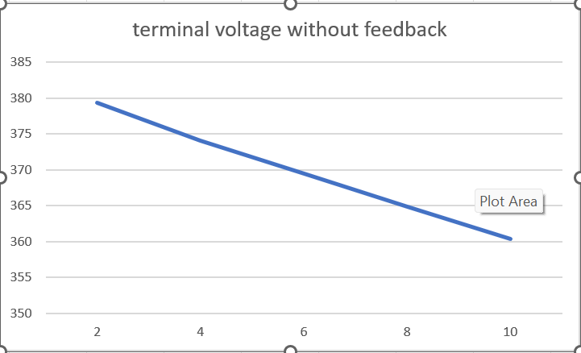
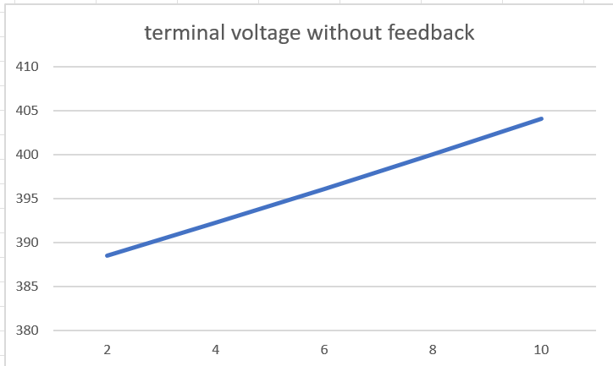
Graph: Changing lagging load without feedback
Graph : Changing leading load without feedback

Slide 10
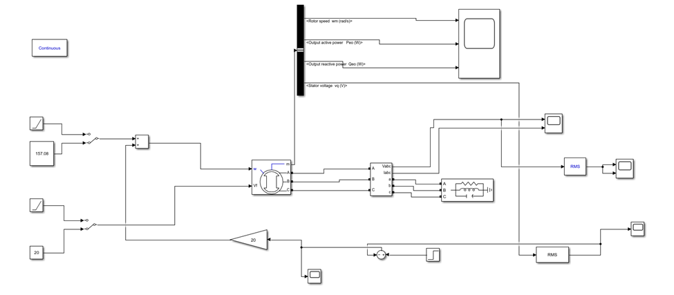
Now, we will do the same thing using feedback to the rotor speed.
Figure: Schematic using feedback in the rotor

Slide 11
The observed results are given in the table:
Lagging load (KVAR) | Terminal voltage
2 | 385.2
4 | 385.1
6 | 385
8 | 384.9
10 | 384.8
Leading load (KVAR) | Terminal voltage
2 | 385.3
4 | 385.5
6 | 385.5
8 | 385.5
10 | 385.6
Table: Changing lagging load
Table: Changing leading load

Slide 12
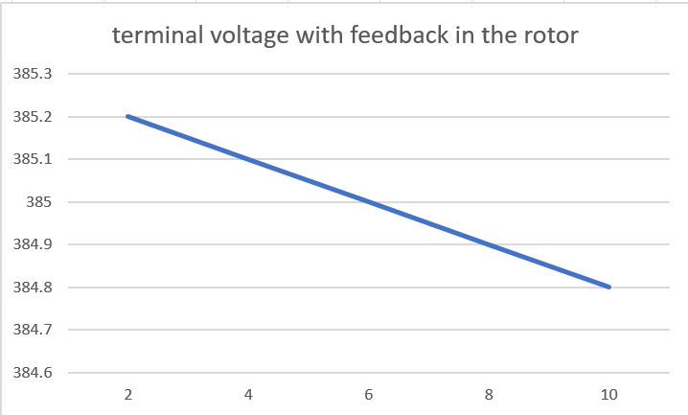
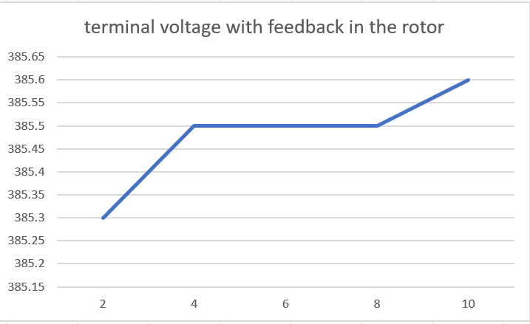
Graph: Changing leading load using feedback in rotor
Graph: Changing lagging load using feedback in rotor

Slide 13
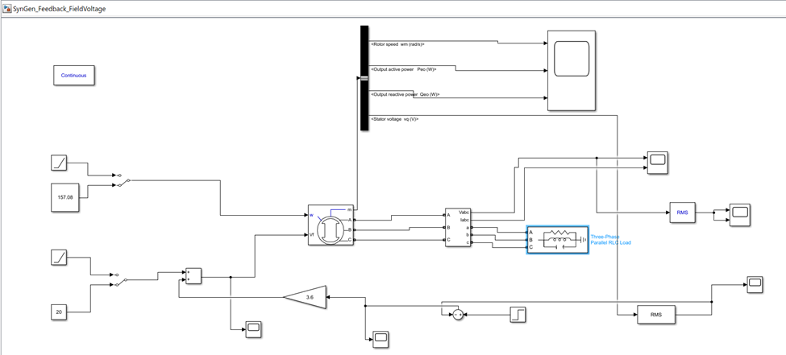
At last, we will again do the same thing but this time taking feedback in the excitor voltage .
Figure: Schematics for feedback in the excitor voltage.

Slide 14
The observed results are given in the table:
Lagging load (KVAR) | Terminal voltage
2 | 385.5
4 | 384.7
6 | 384.6
8 | 384.9
10 | 385
Leading load(KVAR) | Terminal voltage
2 | 385.3
4 | 385.3
6 | 385.4
8 | 385.5
10 | 385.5
Table: Changing lagging load
Table: Changing leading load

Slide 15
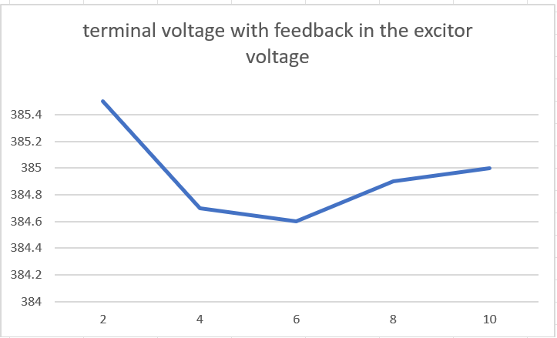
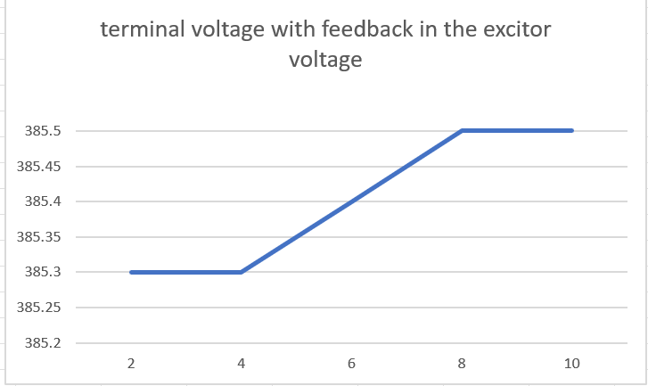
Graph: Changing lagging using feedback in excitor voltage
Graph: Changing leading load using feedback in excitor voltage

Slide 16
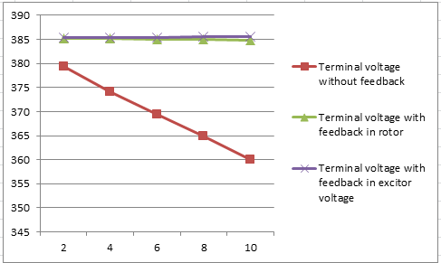
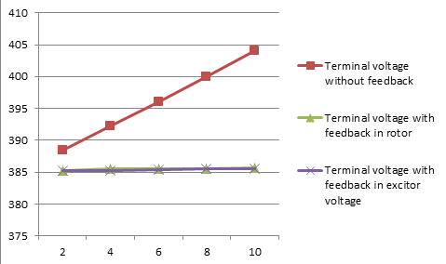
Graph: Comparative study for changing the lagging load using all methods
Graph: Comparative study for changing the lagging load using all methods

Slide 17
Observations:
Increasing lagging load decreases the terminal voltage.
Increasing leading load increases the terminal voltage
Using feedback brings more stability to the output voltage.
Using feedback in excitor voltage makes it more stable than using feedback in rotor

Slide 18
Power factor correction
Power factor changes with the change of load
Here we have solved this problem using a capacitor bank in parallel to the load

Slide 19
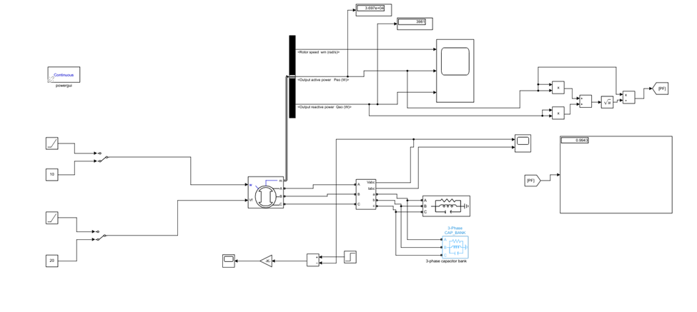
Figure: Schematics for power factor correction

Slide 20
Now we will correct the power factor varying load and using capacitor bank. The real power(10kW) and the leading load for this was kept constant (1VAR) .We have recorded our observed data in the given table:
Load in capacitive bank used | Lagging load (KVAR) | Corrected pf
8000 | 2 | .9984
12800 | 4 | .9965
17800 | 6 | .9947
22800 | 8 | .9941
27800 | 10 | .9943

Slide 21
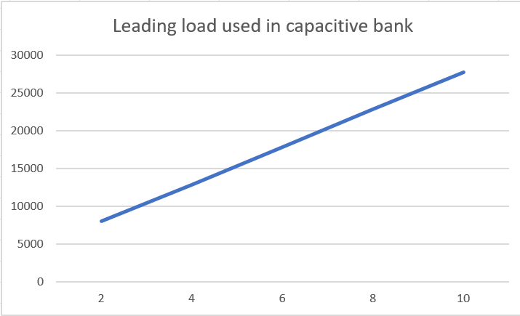

Slide 22
Observation:
As we increased the lagging load, the reactive power of the capacitive bank also needed to be increased

Slide 23


